Slide 1
SUB 1V BG Design
Harshit Gupta
MS EE (Analog and Mixed Signal)
Texas A&M University
Reference Used : B. Razavi, "The Design of a Low-Voltage Bandgap Reference [The Analog Mind]," in IEEE Solid-State Circuits Magazine, vol. 13, no. 3, pp. 6-16, Summer 2021, doi: 10.1109/MSSC.2021.3088963. keywords: {Integrated circuits;Low voltage;Photonic band gap;Perturbation methods;Switches;Voltage control;Transient analysis;Operational amplifiers;Resistors;Low-pass filters},

Slide 2
Contents :
SPEC Table
Topology Used
Basic Operation (First Hand Calculation)
DC Sims across PVT
Why Choose M=8?
Error Amp Design
PSRR calculations and Sims
-ve FB Loop in the Bandgap circuit
Startup Circuit, TRAN SIM (Slow and Fast Ramp Rate)
Final Spec Table

Slide 3
Target Specs
Output Voltage : 0.3 Volts
Output Voltage Variation < 1 % (0 ℃ to 100 ℃)
Supply Rejection > 40 dB
Power Consumption < 1 mW
Supply Voltage : 1.2 Volts ± 5 % (1.14 to 1.26 Volts)

Slide 4
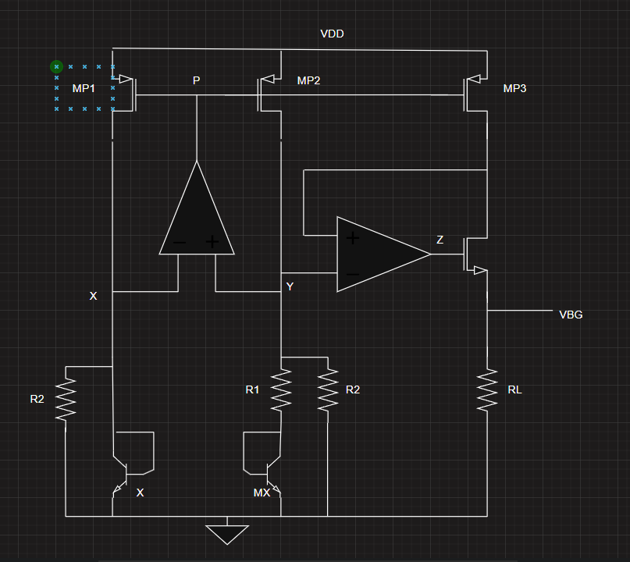
Topology Used
Note :
Startup circuit is included later in the schematics section
Both Error Amps have the same input common mode range so they were re-used. (More details in the EA section)

Slide 5
Basic Operation
→ OPAMP Ensures Vx = Vy
⇒ Vbe1 = Vbe2 + I_R1*R1
⇒ I_R1 = Vt*ln(M)/R1
Now I_MP2 = I_MP1 (their W/L is same)
So I_MP = Vt*ln(M)/R1 + Vbe1/R2
Vbg = RL*(I_MP)
Vbg = RL/R1 *(Vt*ln(M) + (R1/R2)*Vbe1)
Now resistors are sized such that tempco is zero (just at 27 degree centigrade)
We can’t cancel the tempco at all the temperatures since the slope also changes with temperature but cancelling the tempco just at 27 would give good accuracy.
Vbg = RL/R1 * (PTAT + NTAT)
Slope (Vt*ln(M)) = (-1)*Slope(R1/R2 * Vbe1)
0.087*ln(M) = 1.702*(R1/R2)
→ Cancellation is done only at 27 ℃
→ Slope of Vbe is confirmed from the simulation (slide 6)
M=8
R1/R2 = 0.106
R1=1.5 KΩ
R2 = 14.15 KΩ
Now for Vbg = 0.3 Volts
RL = 3.416 KΩ
First Cut R numbers are :
R1 : 1.5 KΩ
R2 : 14.15 KΩ
R3 : 3.416 KΩ

Slide 6
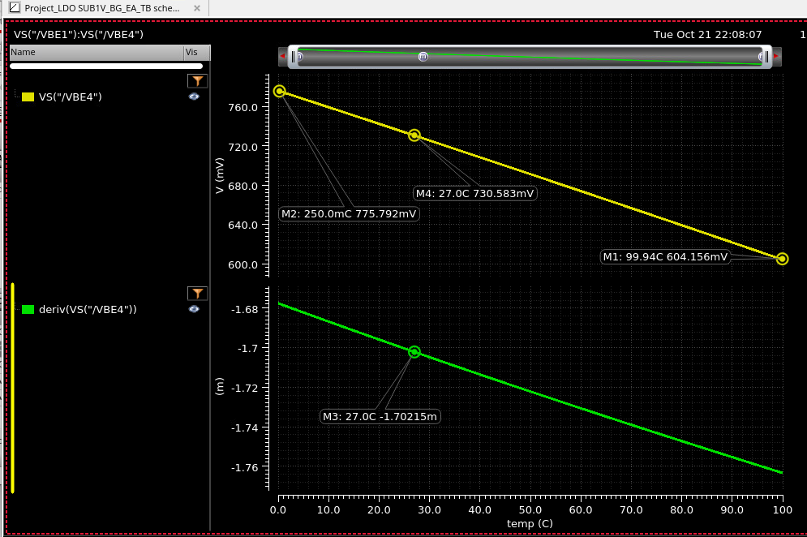
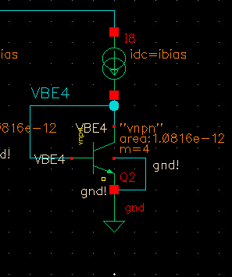
Ibias : 35uA (Vtln(8)/1.5K) assumed R1 : 1.5K

Slide 7
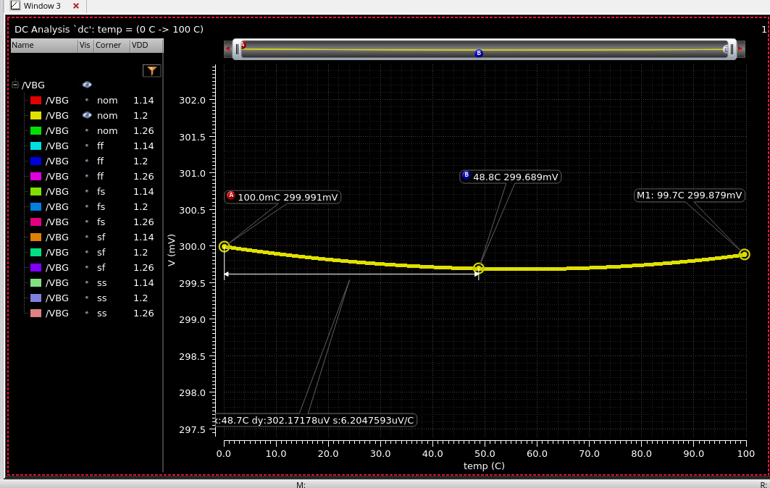
DC Sim (Nominal)
Note : The Handcalculation didn’t give the umbrella curve so using simulation the resistor values were tweaked in order to achieve that

Slide 8
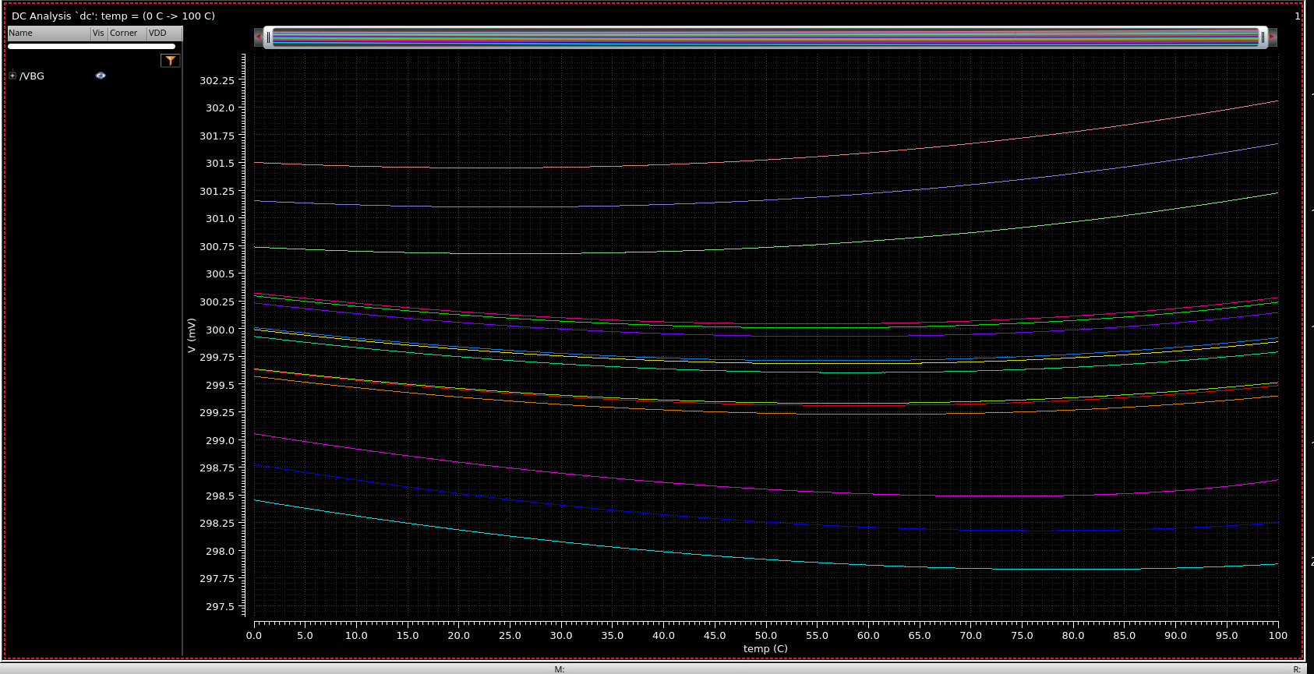
DC Sims Across PVT (5 Process corners, 3 Supply Corners, 3 Temperature points 0,27,100)
We can see that across the process Vbe values changes which changes the effective Vbg value as well, this requires resistor trimming techniques which ensures the slope cancellation and Vbg value maintained at 300mV.

Slide 9
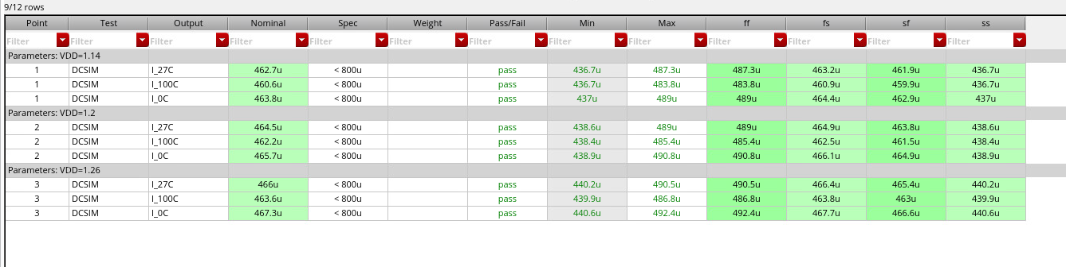
Power Consumption
Max Power @ 1.2 Volts = 1.2*490uA = 0.58mW
Current Distribution : Around 200uA in Error Amps, 3*(0.3/3.86K) in the three branches : 233uA
And some biasing branches

Slide 10
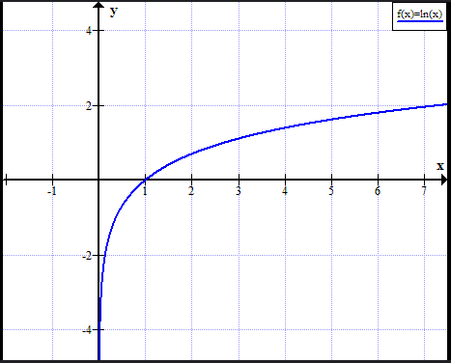
Why Choose M=8 ?
If we have a Vos (input referred offset of the opamp) then Vbg expression comes out to be :
Vbg = RL/R2(Vbe1 + R2/R1 * Vt*ln(M) – (1+R2/R1)*Vos)
Now to reduce the effect of the offset R2/R1 needs to be minimized, to still get the flat Vbg we need to increase
value of M so that temperature slopes are cancelled.
But we can’t increase the value of M forever as it consumes significant area.
M=2 , ln(2) = 0.693
M=4 , ln(4) = 1.386
M=8, ln(8) = 2.079
M=16 , ln(16) = 2.77
The percentage increase in the values as M increases seems to decrease, so choosing 8 seems to be good
Tradeoff.
M2
M2
M2
M2
M1
M2
M2
M2
M2
Notes:
M2

Slide 11
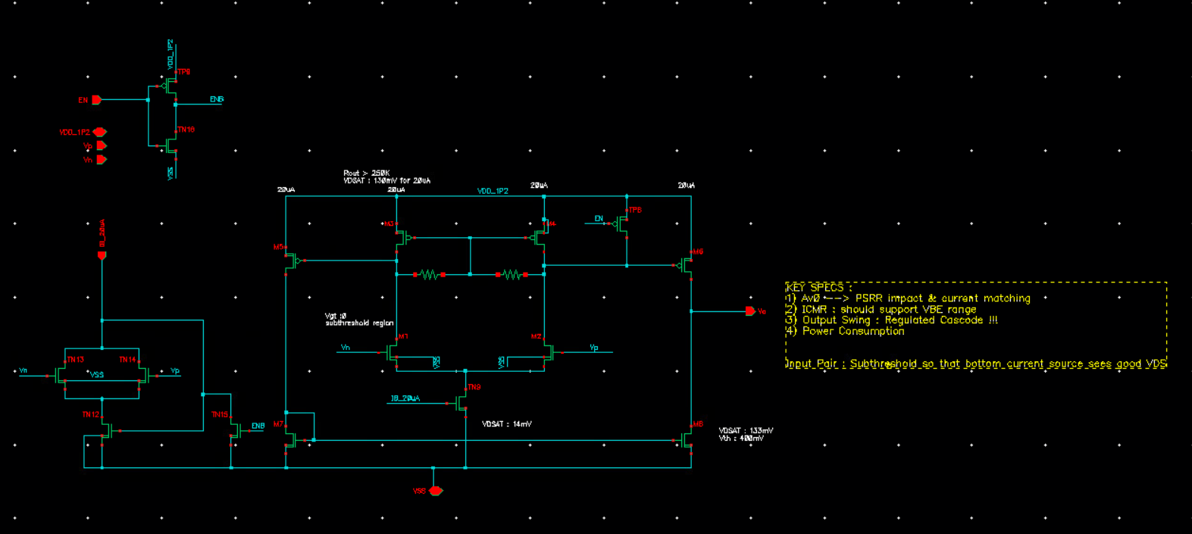
Error Amp Design
Since the input of the error amp is at voltage level of Vbe1 (Vx) that why the ICMR should be decided by that which is 601mV to 775mV (slide 6) → NMOS input pair based ERROR AMP was chosen.
Current mirror type opamp but with some additional resistors in the first stage which gives boost to DC gain.
→Gain : Impacts overall accuracy, PSRR
→Should support a ICMR of VBE range across temperature (0.6 to 0.75mV)
Its output swing should also include Vbg+Vgs (output stage of the bandgap circuit has a regulated cascode structure)
There are two high impedance nodes in this opamp so there was external cap used to stabilize the neg-fb loops in which this opamp was used.

Slide 12
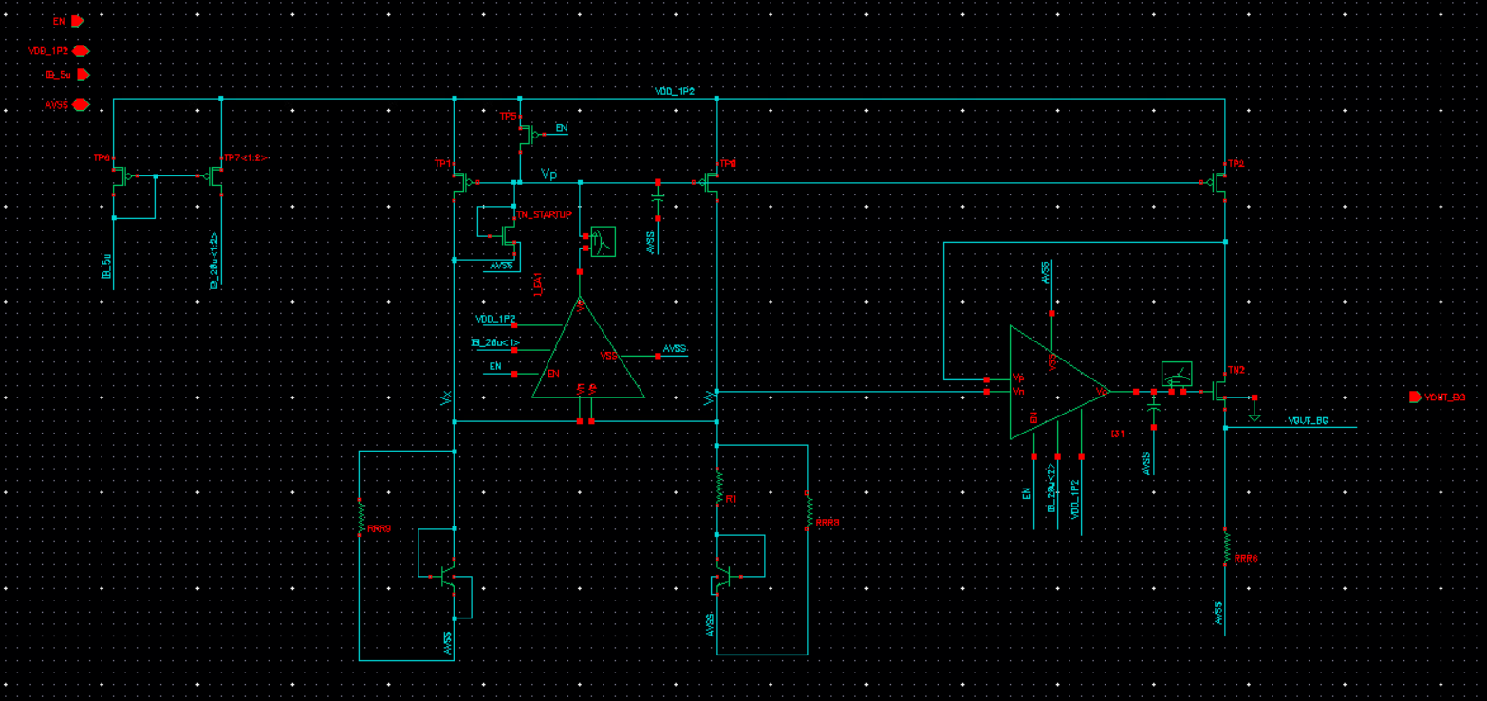
Error Amp Design
Its output swing should also include Vbg+Vgs (output stage of the bandgap circuit has a regulated cascode structure
At the gate of the encircled transistor voltage will be Vbg+ Vgs (and Vgs will be slightly higher than usual due to body effect experienced by TN2)
So EA was designed such that output swing includes this point across temperature

Slide 13
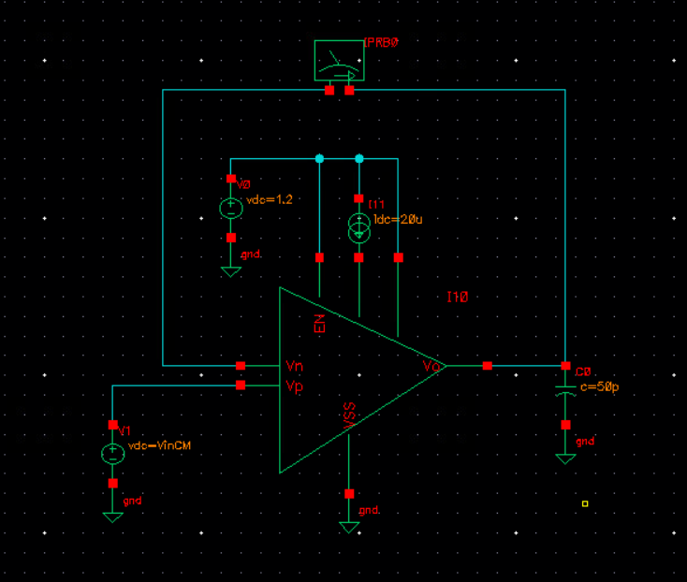
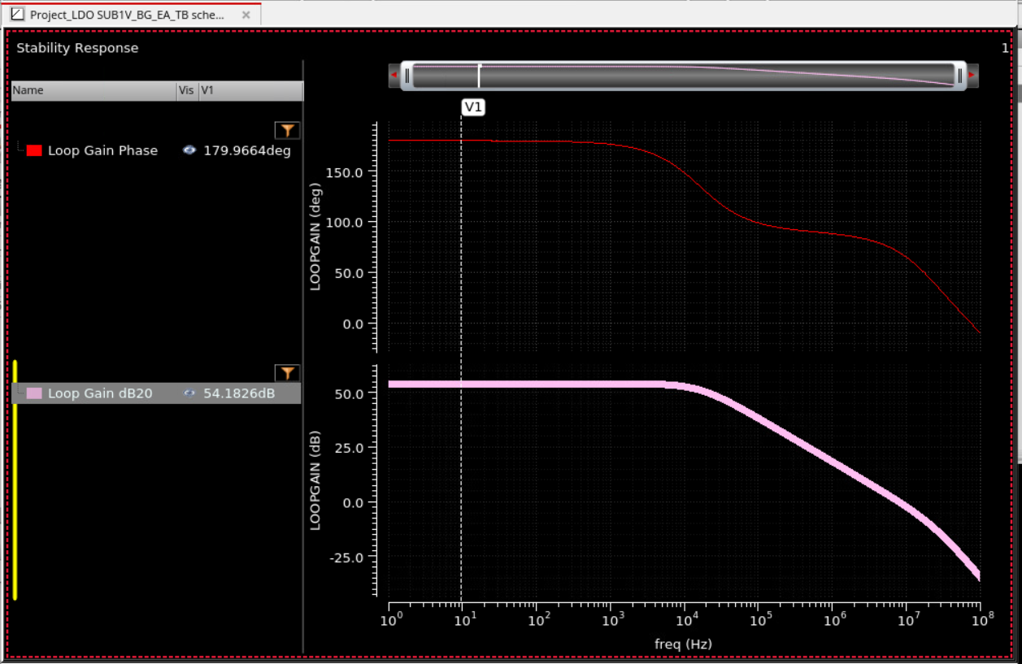
Stand-Alone EA Sim Results
EA Current Consumption : 100uA
54dB DC gain
50pF output was just kept to ensure output node dominant pole
The –ve fb loop involving error amps uses lesser cap (more details in upcoming slides)
Output node impedance : 192Kohms
First Node Impedance : 30Kohms

Slide 14
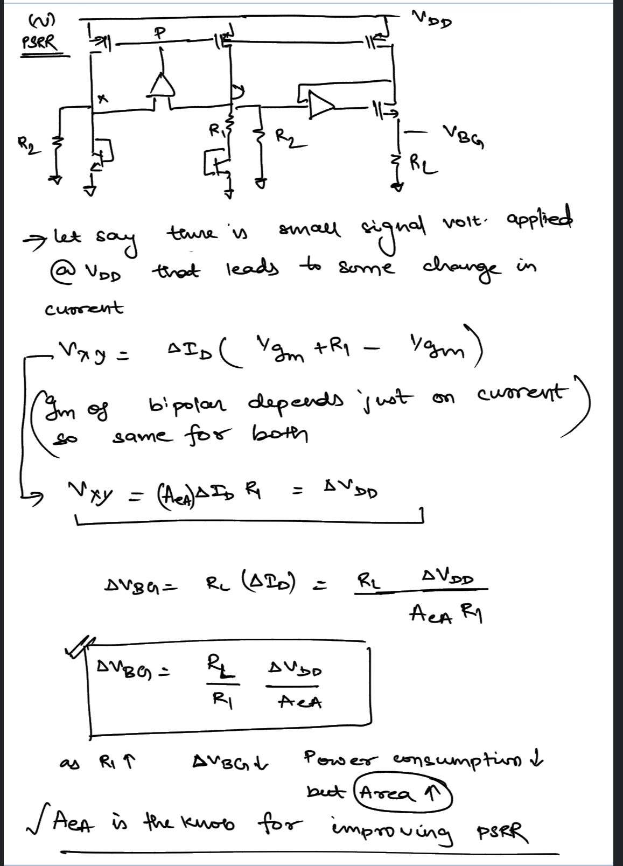
PSRR Calculations
Here its assumed that OPAMP is able to reject all the supply noise, which is indeed the case. PSR of the opamp is high due to the 2 stage structure.

Slide 15
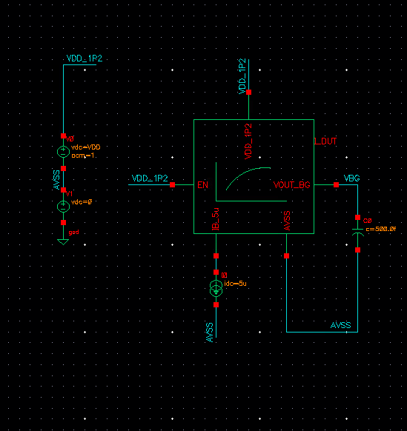
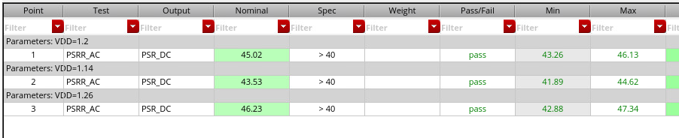
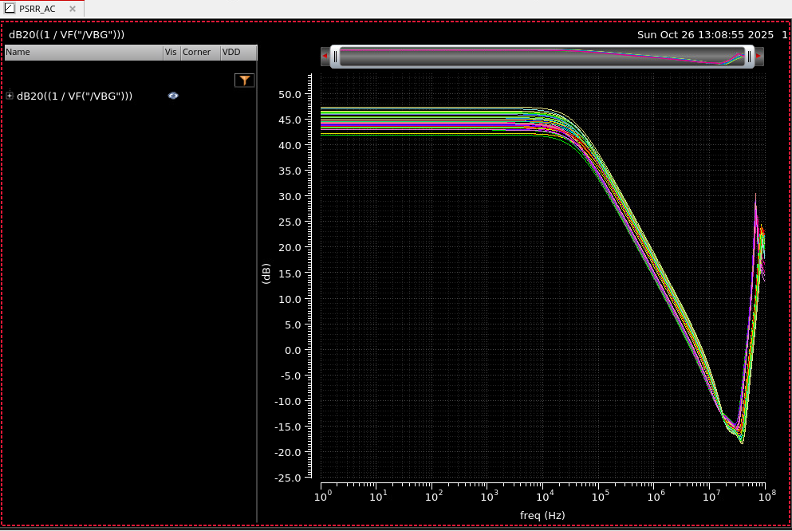
PSRR Sim Results & TB

Slide 16
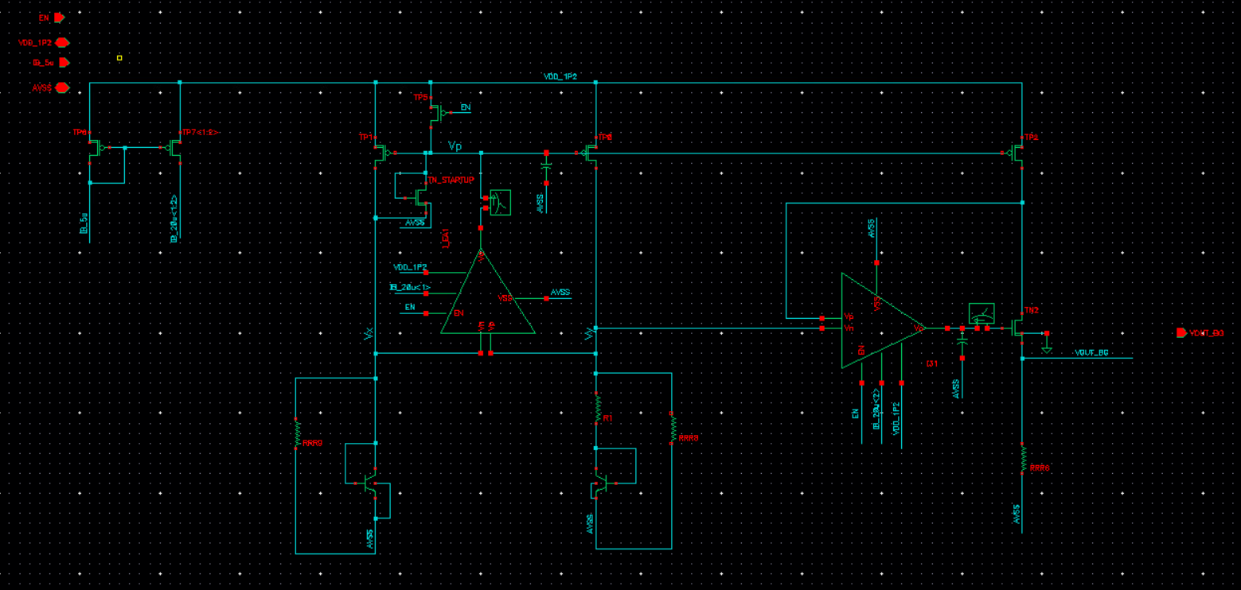
-ve FB loops Stability
LOOP 1
LOOP 2

Slide 17
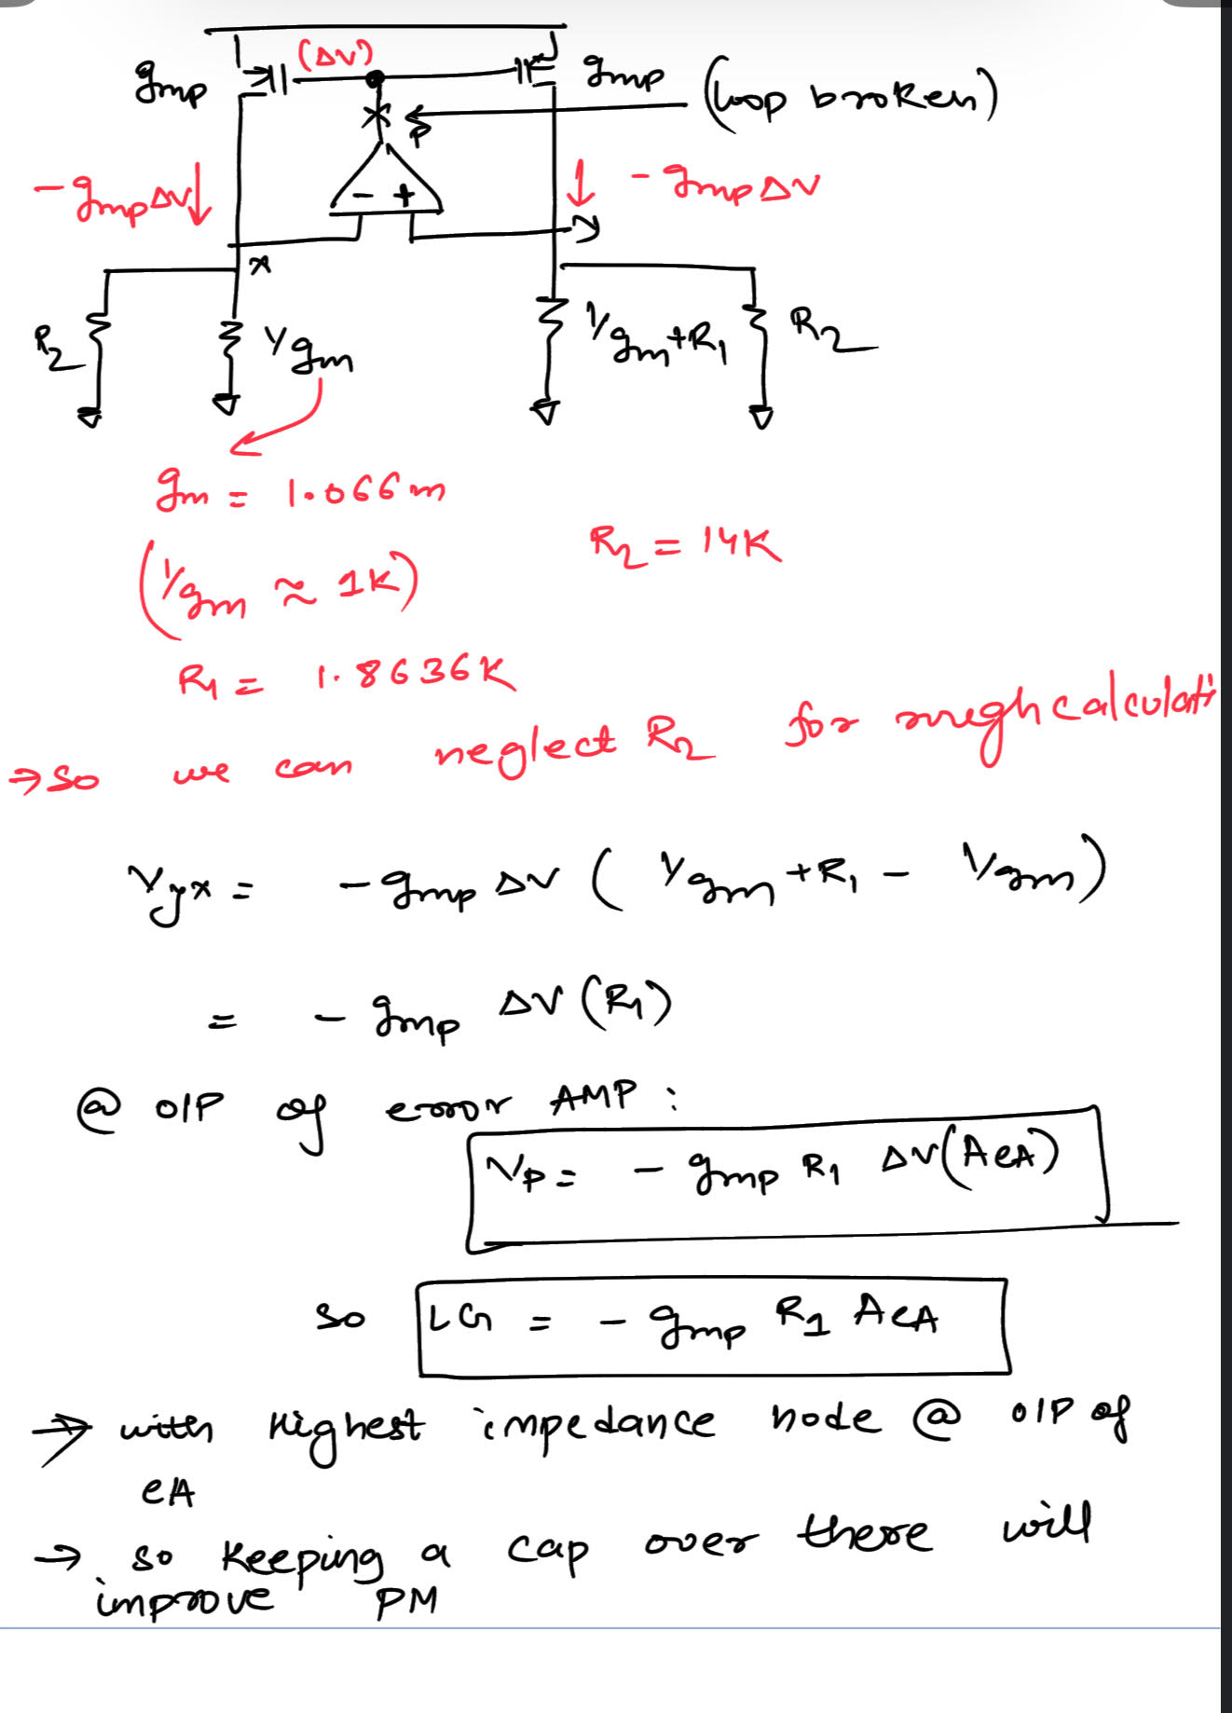
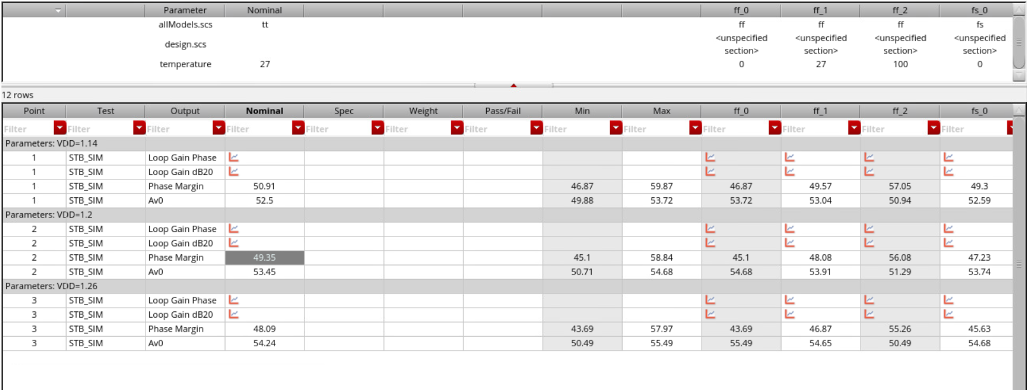
Loop1
Gmp.R1 around 1.44 at nominal conditions
LG nearly same as Error AMP gain
PVT Results across the supply(1.2 + 5% variation)

Slide 18
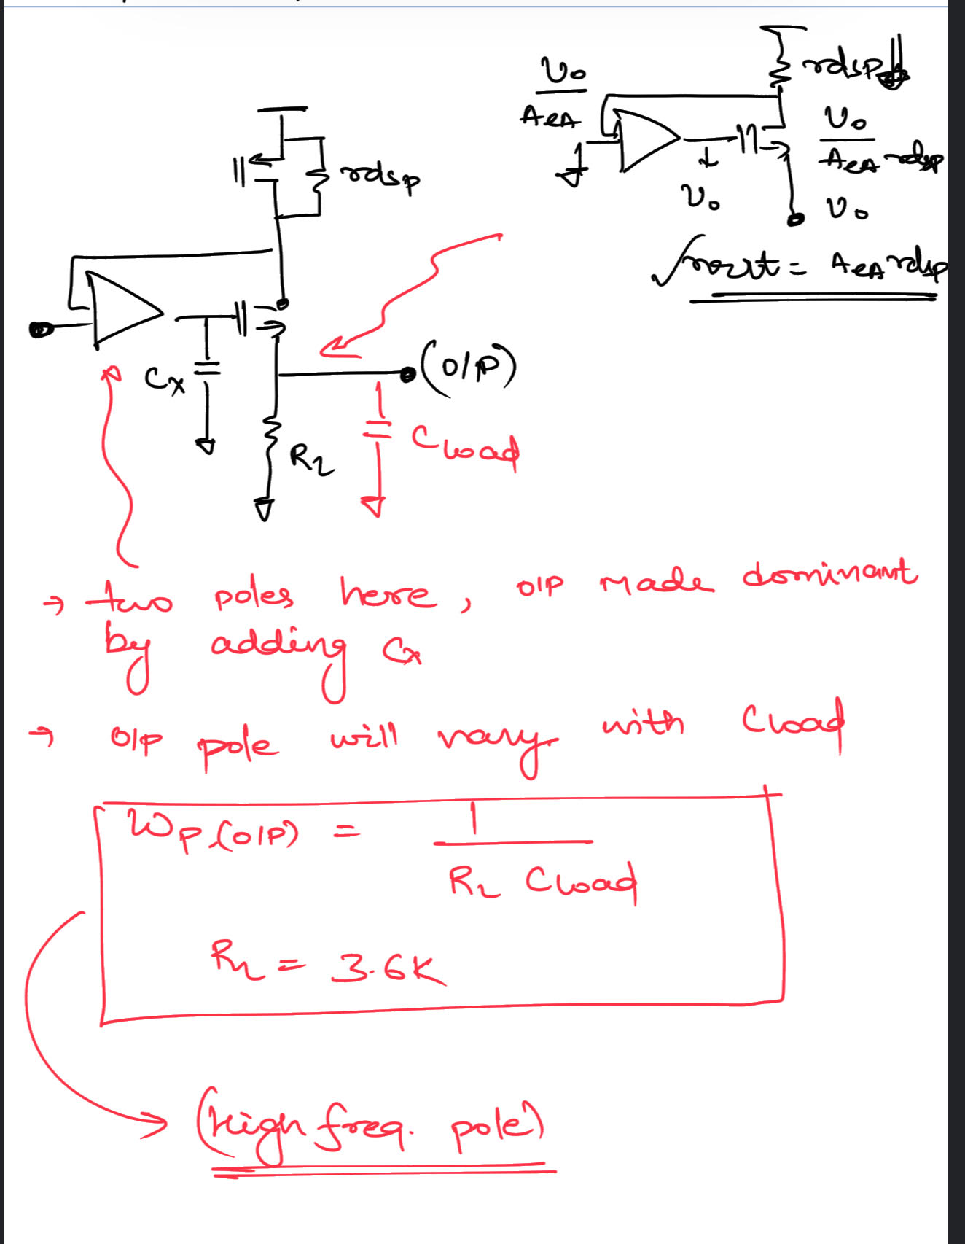
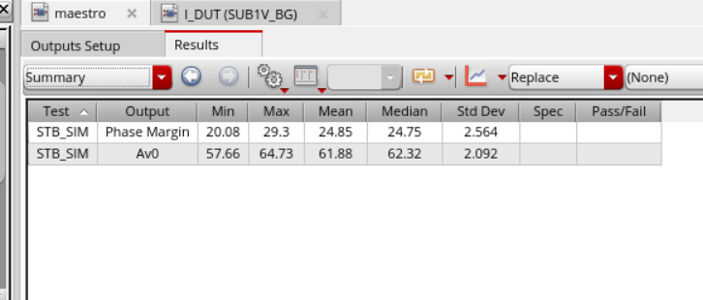
Loop 2
Loop gain is higher than Loop here due to which bandwidth will be slightly higher if we keep the same 20pF at the output of the error amp and which leads lower phase margin as compared to the previous loop.

Slide 19
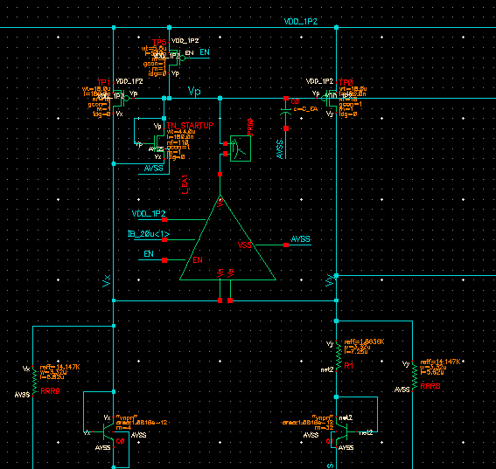
Startup Circuitry
Operation :
So if the startup device was not there than Vx& Vy can just stay at zero with Vp : VDD
Now due to inclusion of this device, it will perturb the node Vx,Vy during the startup and during the steady state it won’t be drawing any current so won’t be disturbing the normal operation.

Slide 20
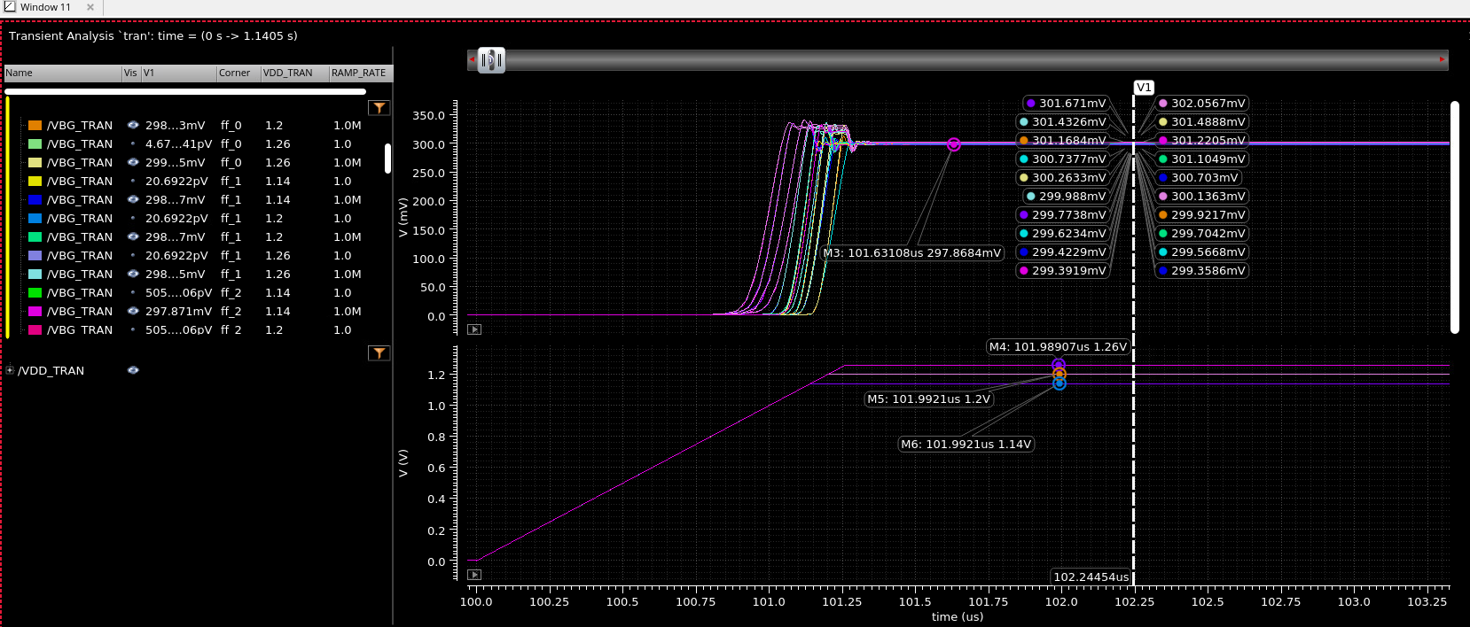
StartUP Sims (1M Ramp Rate at the Supply)

Slide 21
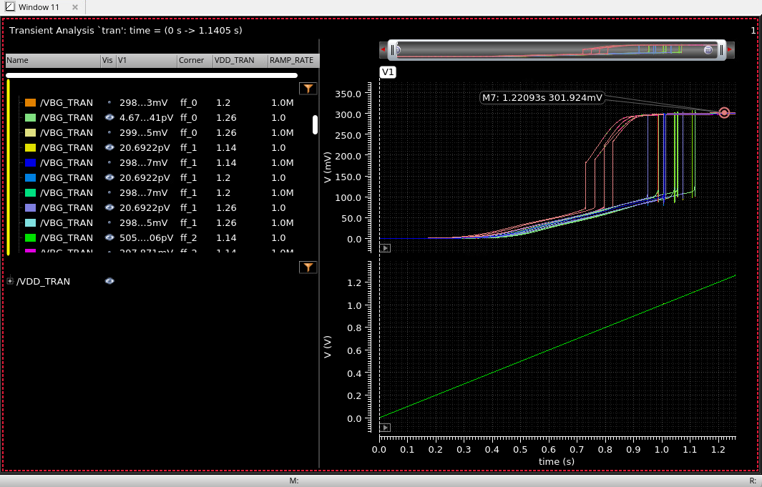
1V Ramp Rate at the Supply

Slide 22
SCM
 | SPEC
DC Accuracy | < 1% across temperature | @nominal 302uV Slide 7
PSRR DC | >40dB | Min PSRR achieved : 41.89 dB (across PVT) Slide 15
Power Consumption | <1mW | 0.58mW Slide 9

